Slide 1
>> IN THE NAME OF ALLAH, THE MOST GRACIOUS, THE MOST MERCIFUL <<
COMPARATIVE FREE-VIBRATION ANALYSIS OF A MDOF STRUCTURE: ELASTIC VS INELASTIC RESPONSE USING OPENSEES. NONLINEAR DYNAMIC ANALYSIS OF A NONPRISMATIC STEEL GABLE FRAME I SECTION COLUMN WITH FINITE PRISMATIC COLUMN
WRITTEN BY SALAR DELAVAR GHASHGHAEI (QASHQAI)

Slide 2
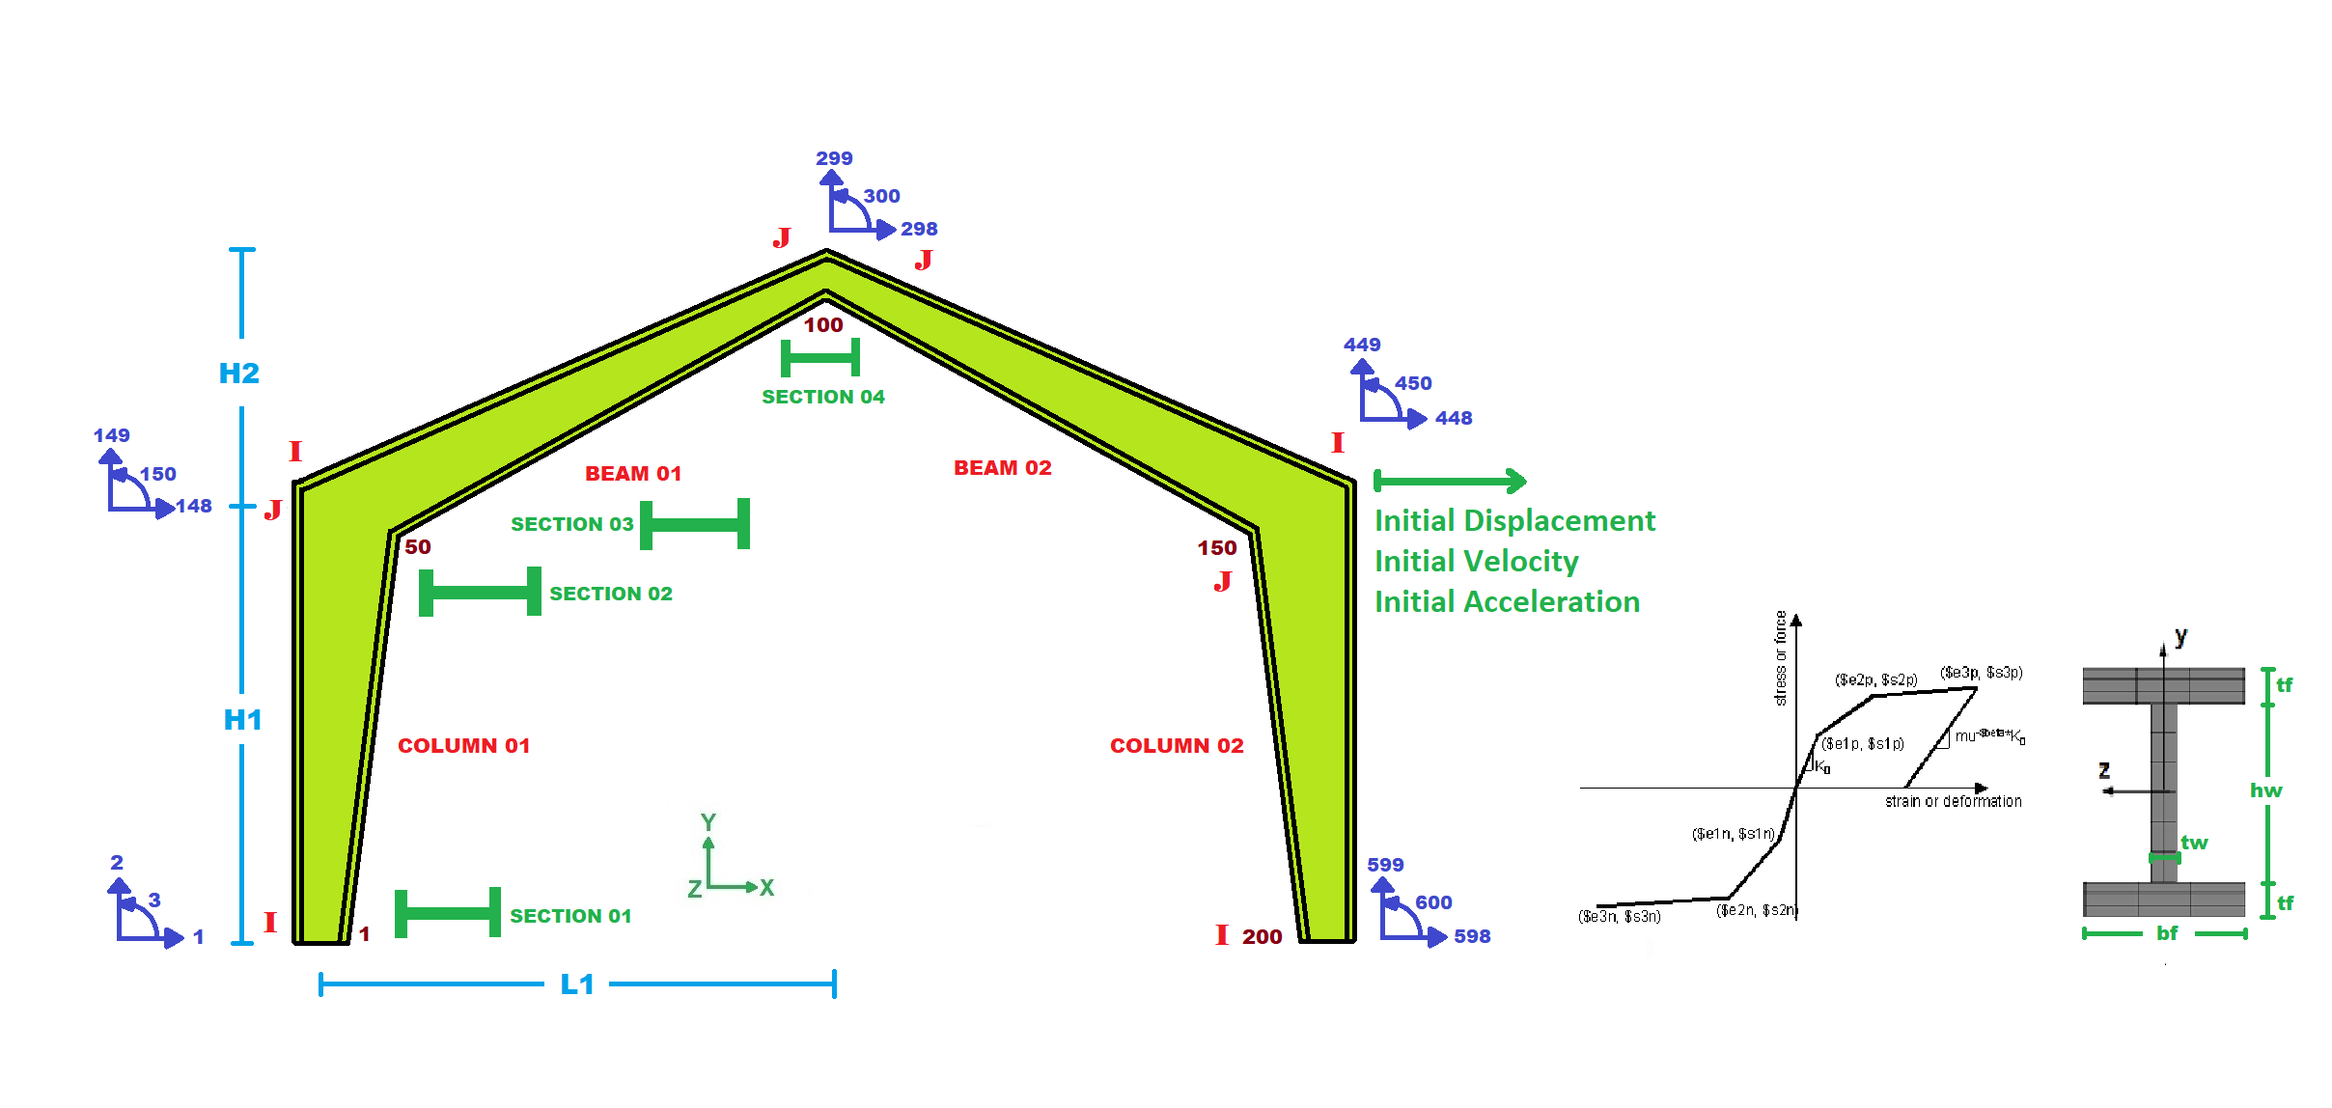

Slide 3
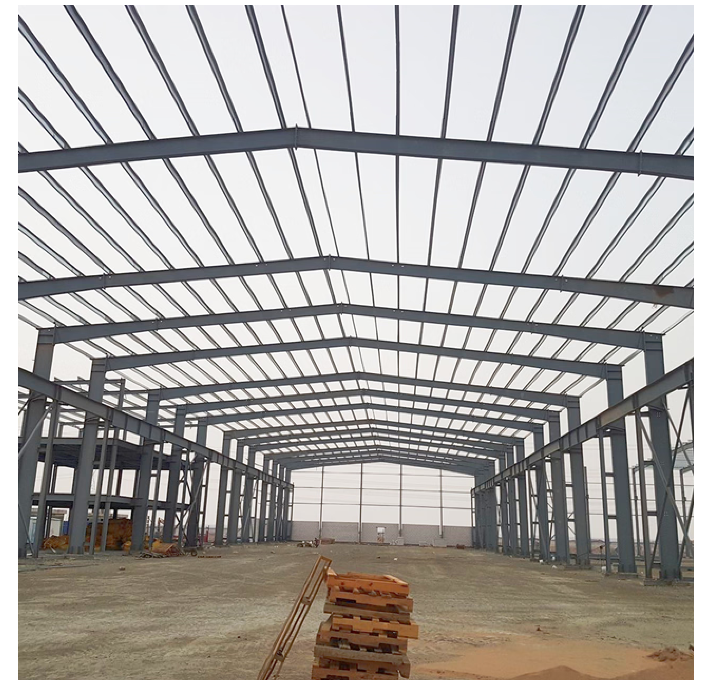

Slide 4
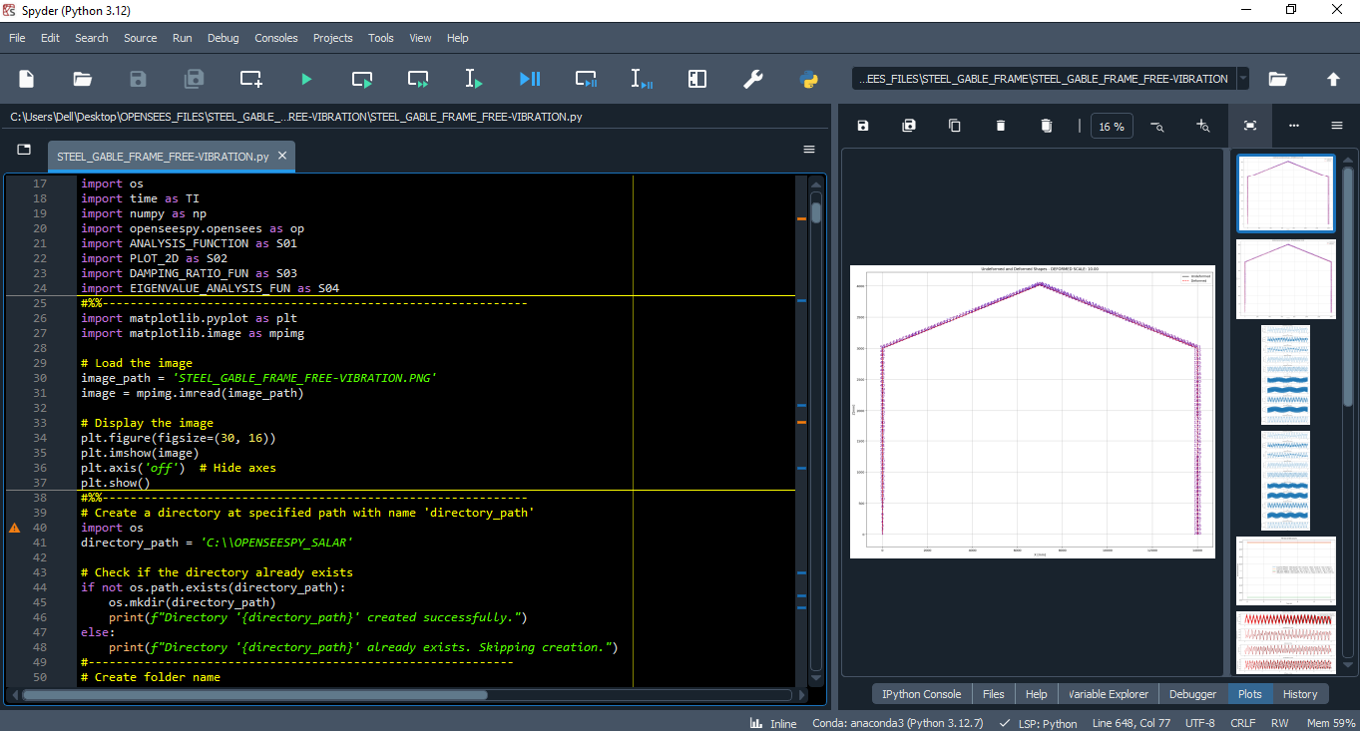

Slide 5
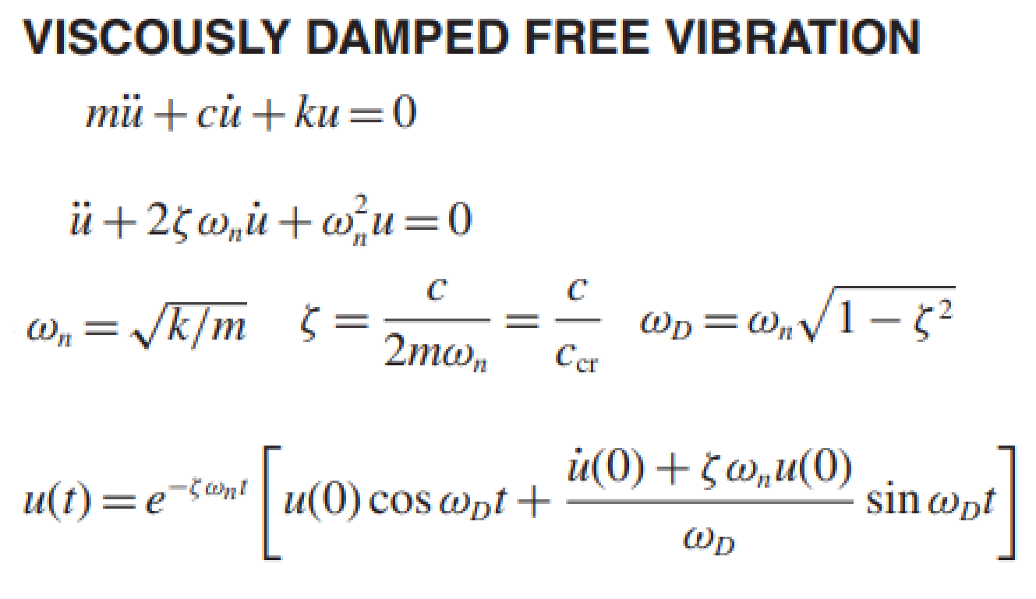
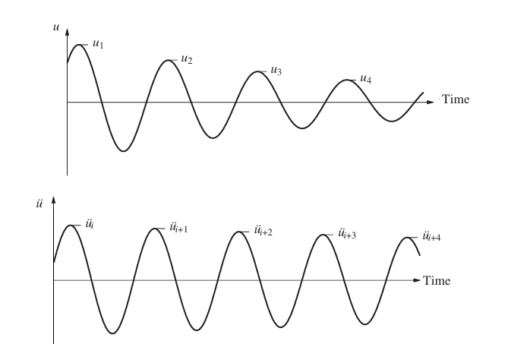
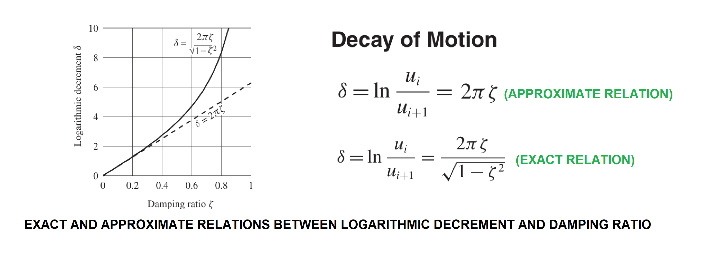
Exact Damping Ratio: 1.50494054e-04

Slide 6
FREE-VIBRATION ANALYSIS FOR INELASTIC STRUCTURE

Slide 7
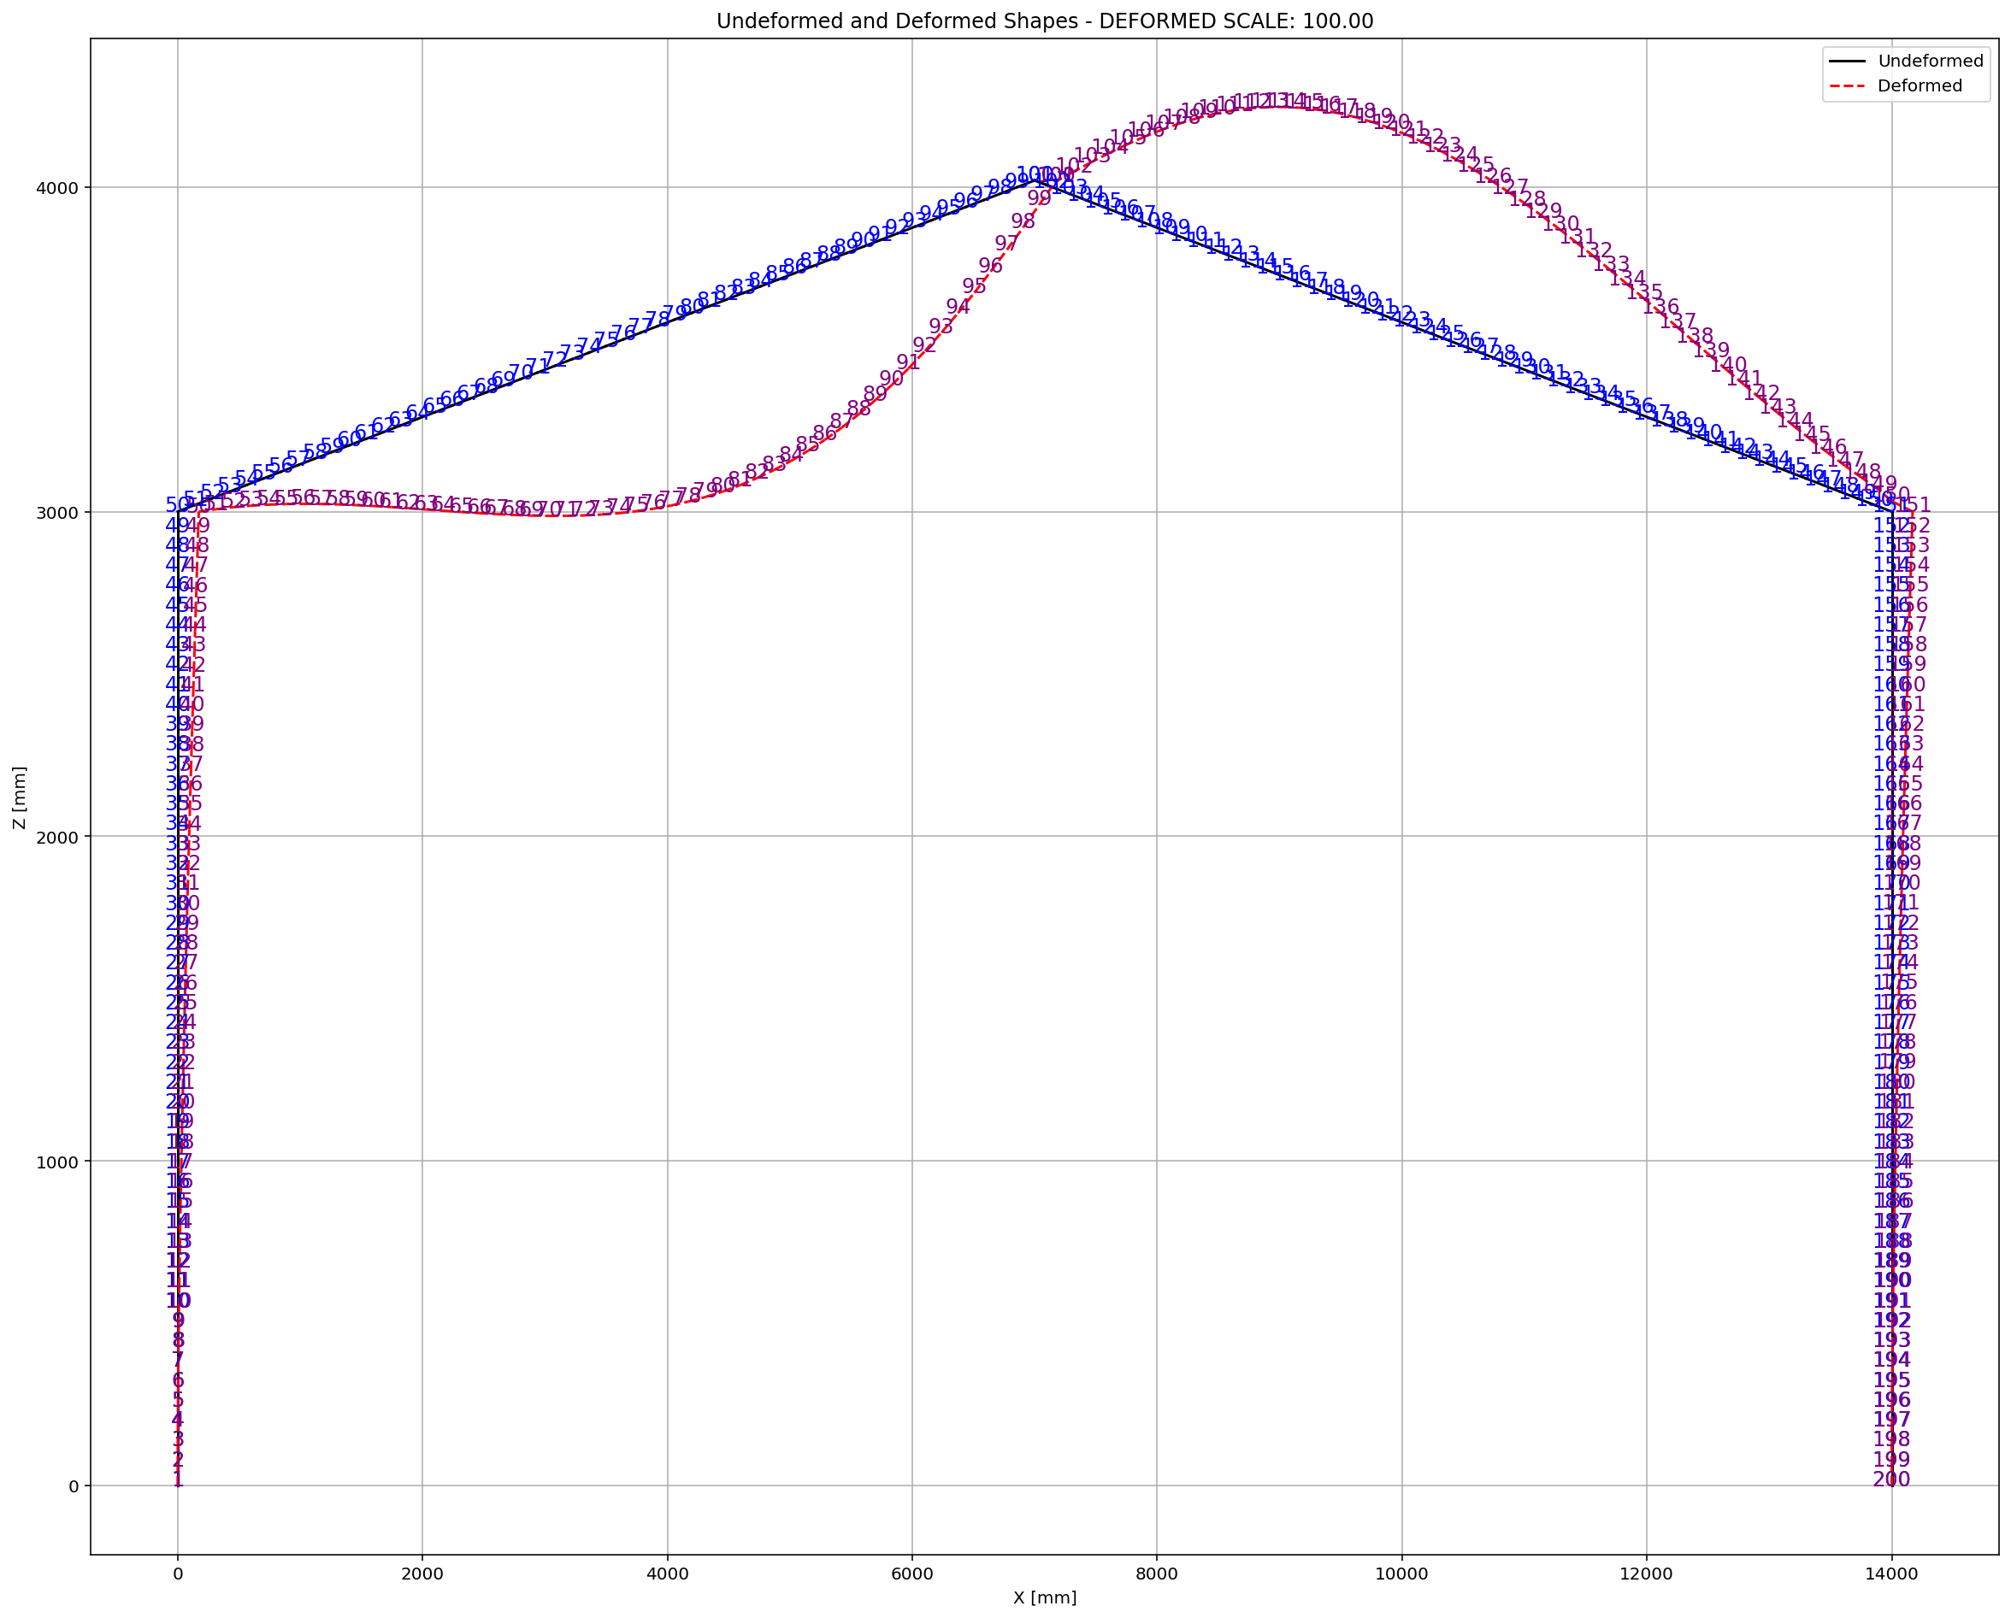

Slide 8
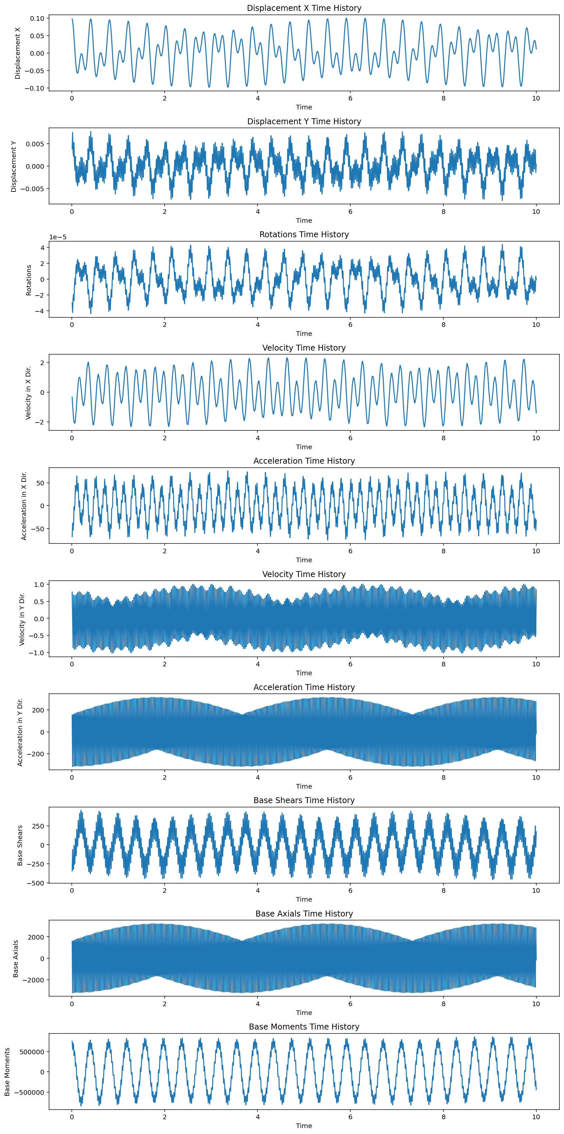

Slide 9
FREE-VIBRATION ANALYSIS FOR ELASTIC STRUCTURE

Slide 10
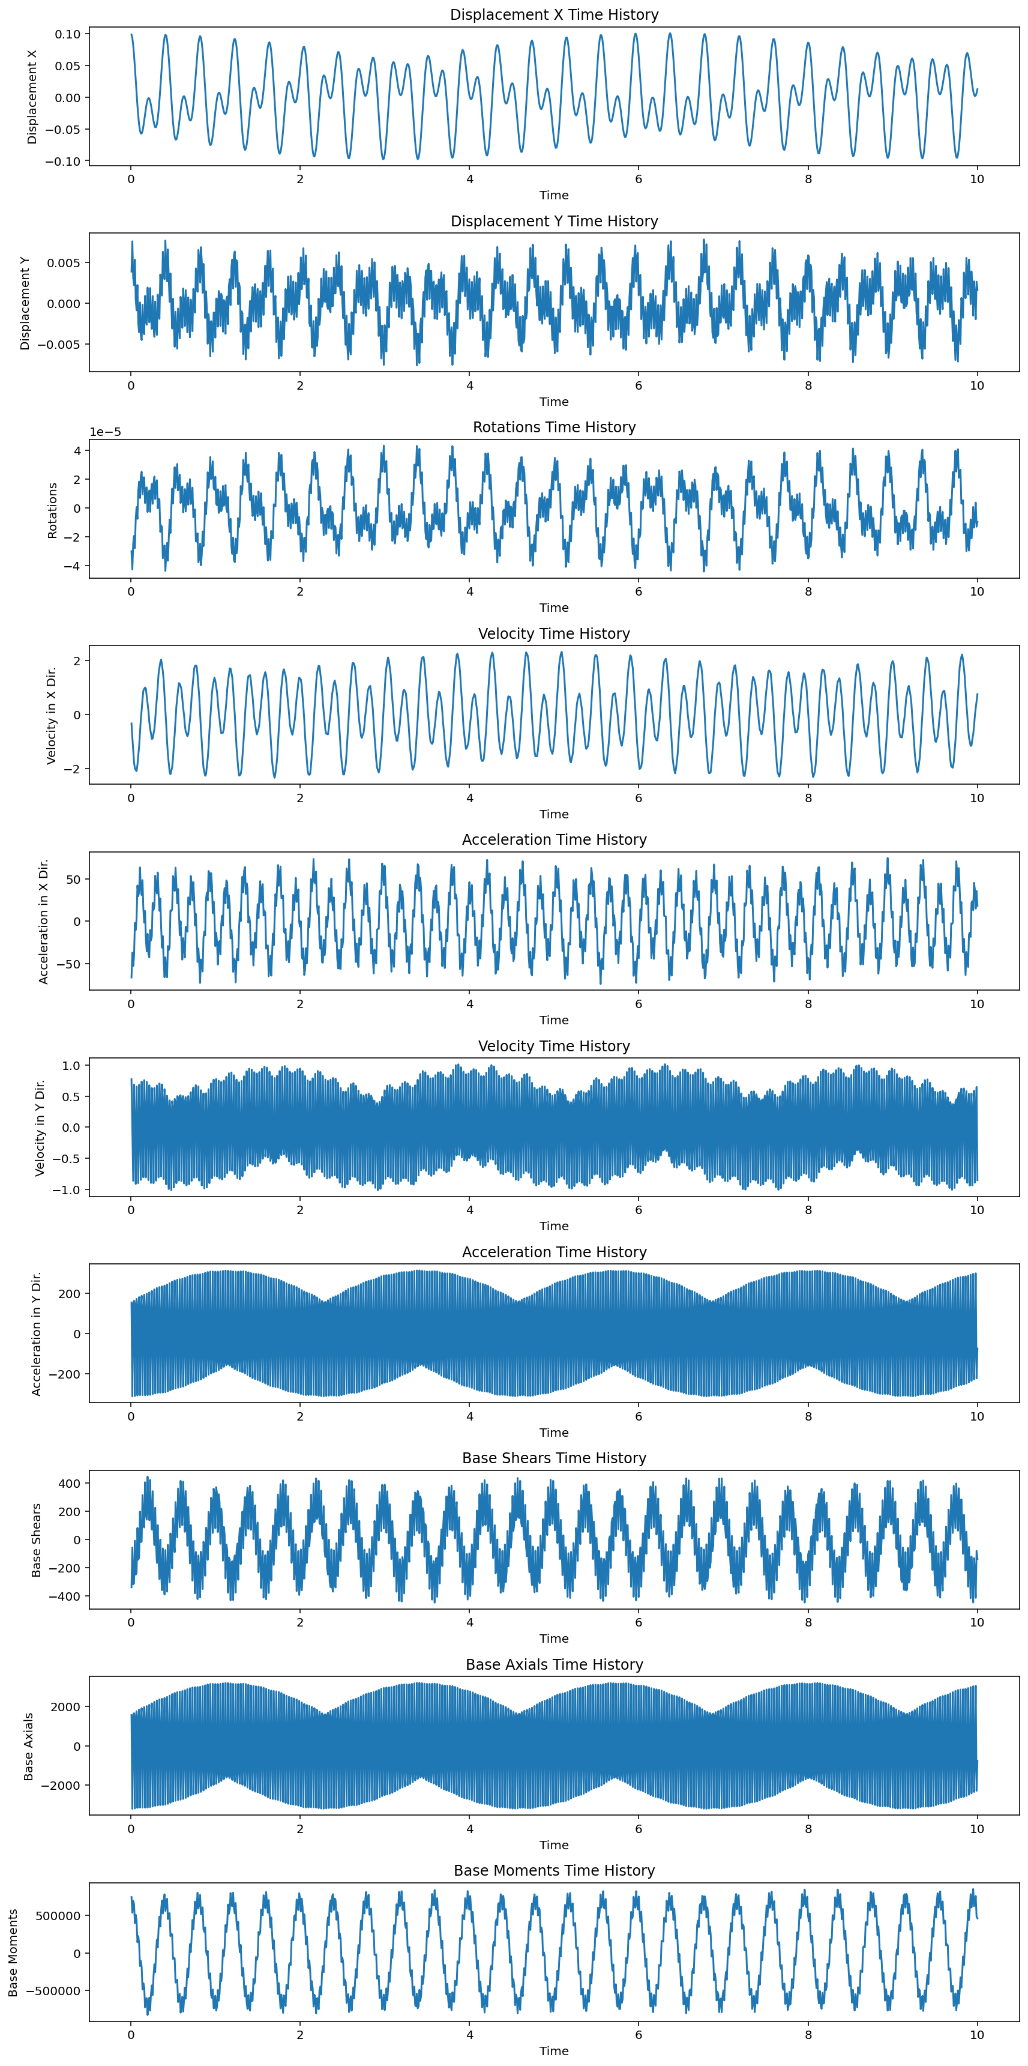

Slide 11
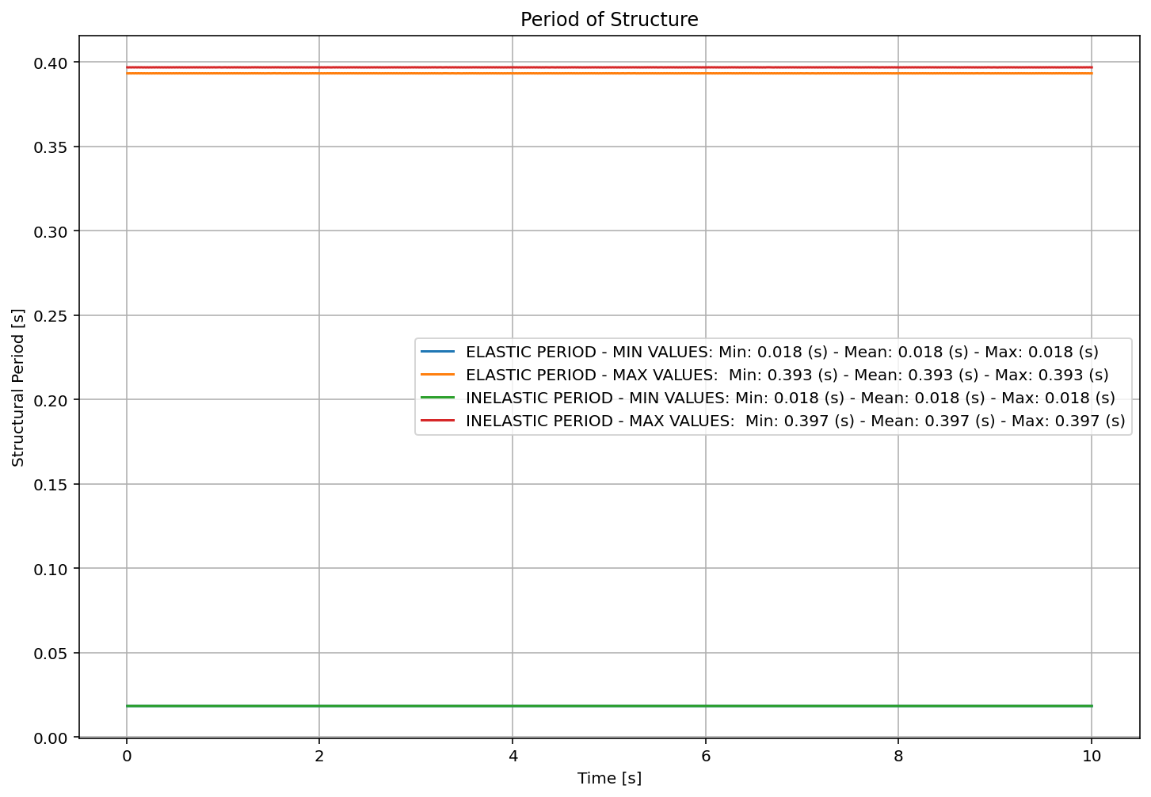

Slide 12
